Slide 1
Tuong lab notebook and scripts management onboarding
14/07/2023

Slide 2
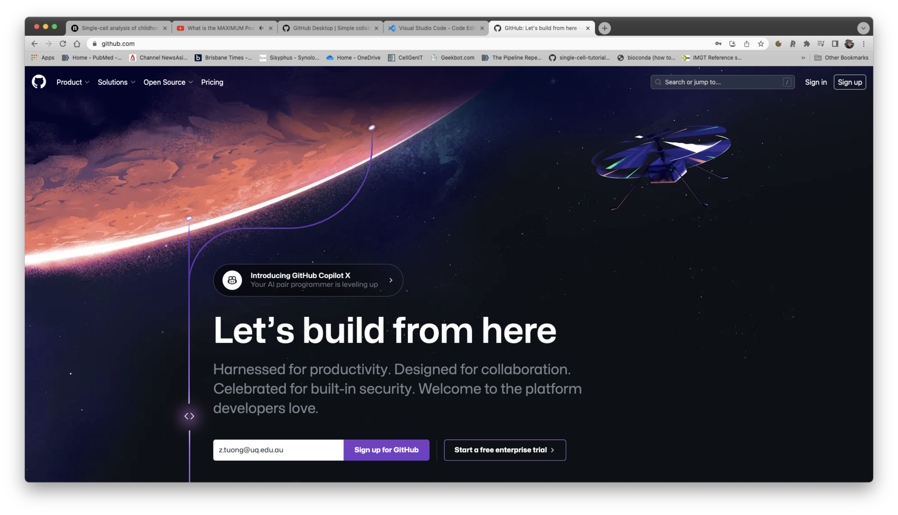
1) Pre-requisites
Create a github account and let me know your user id
https://github.com/

Slide 3
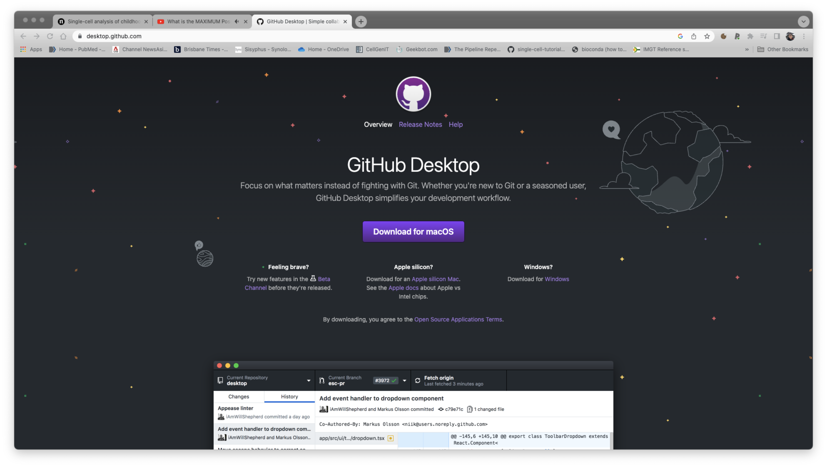
Install GitHub Desktop
https://desktop.github.com/
Open it up and sign in with
your GitHub credentials
when the download is complete

Slide 4
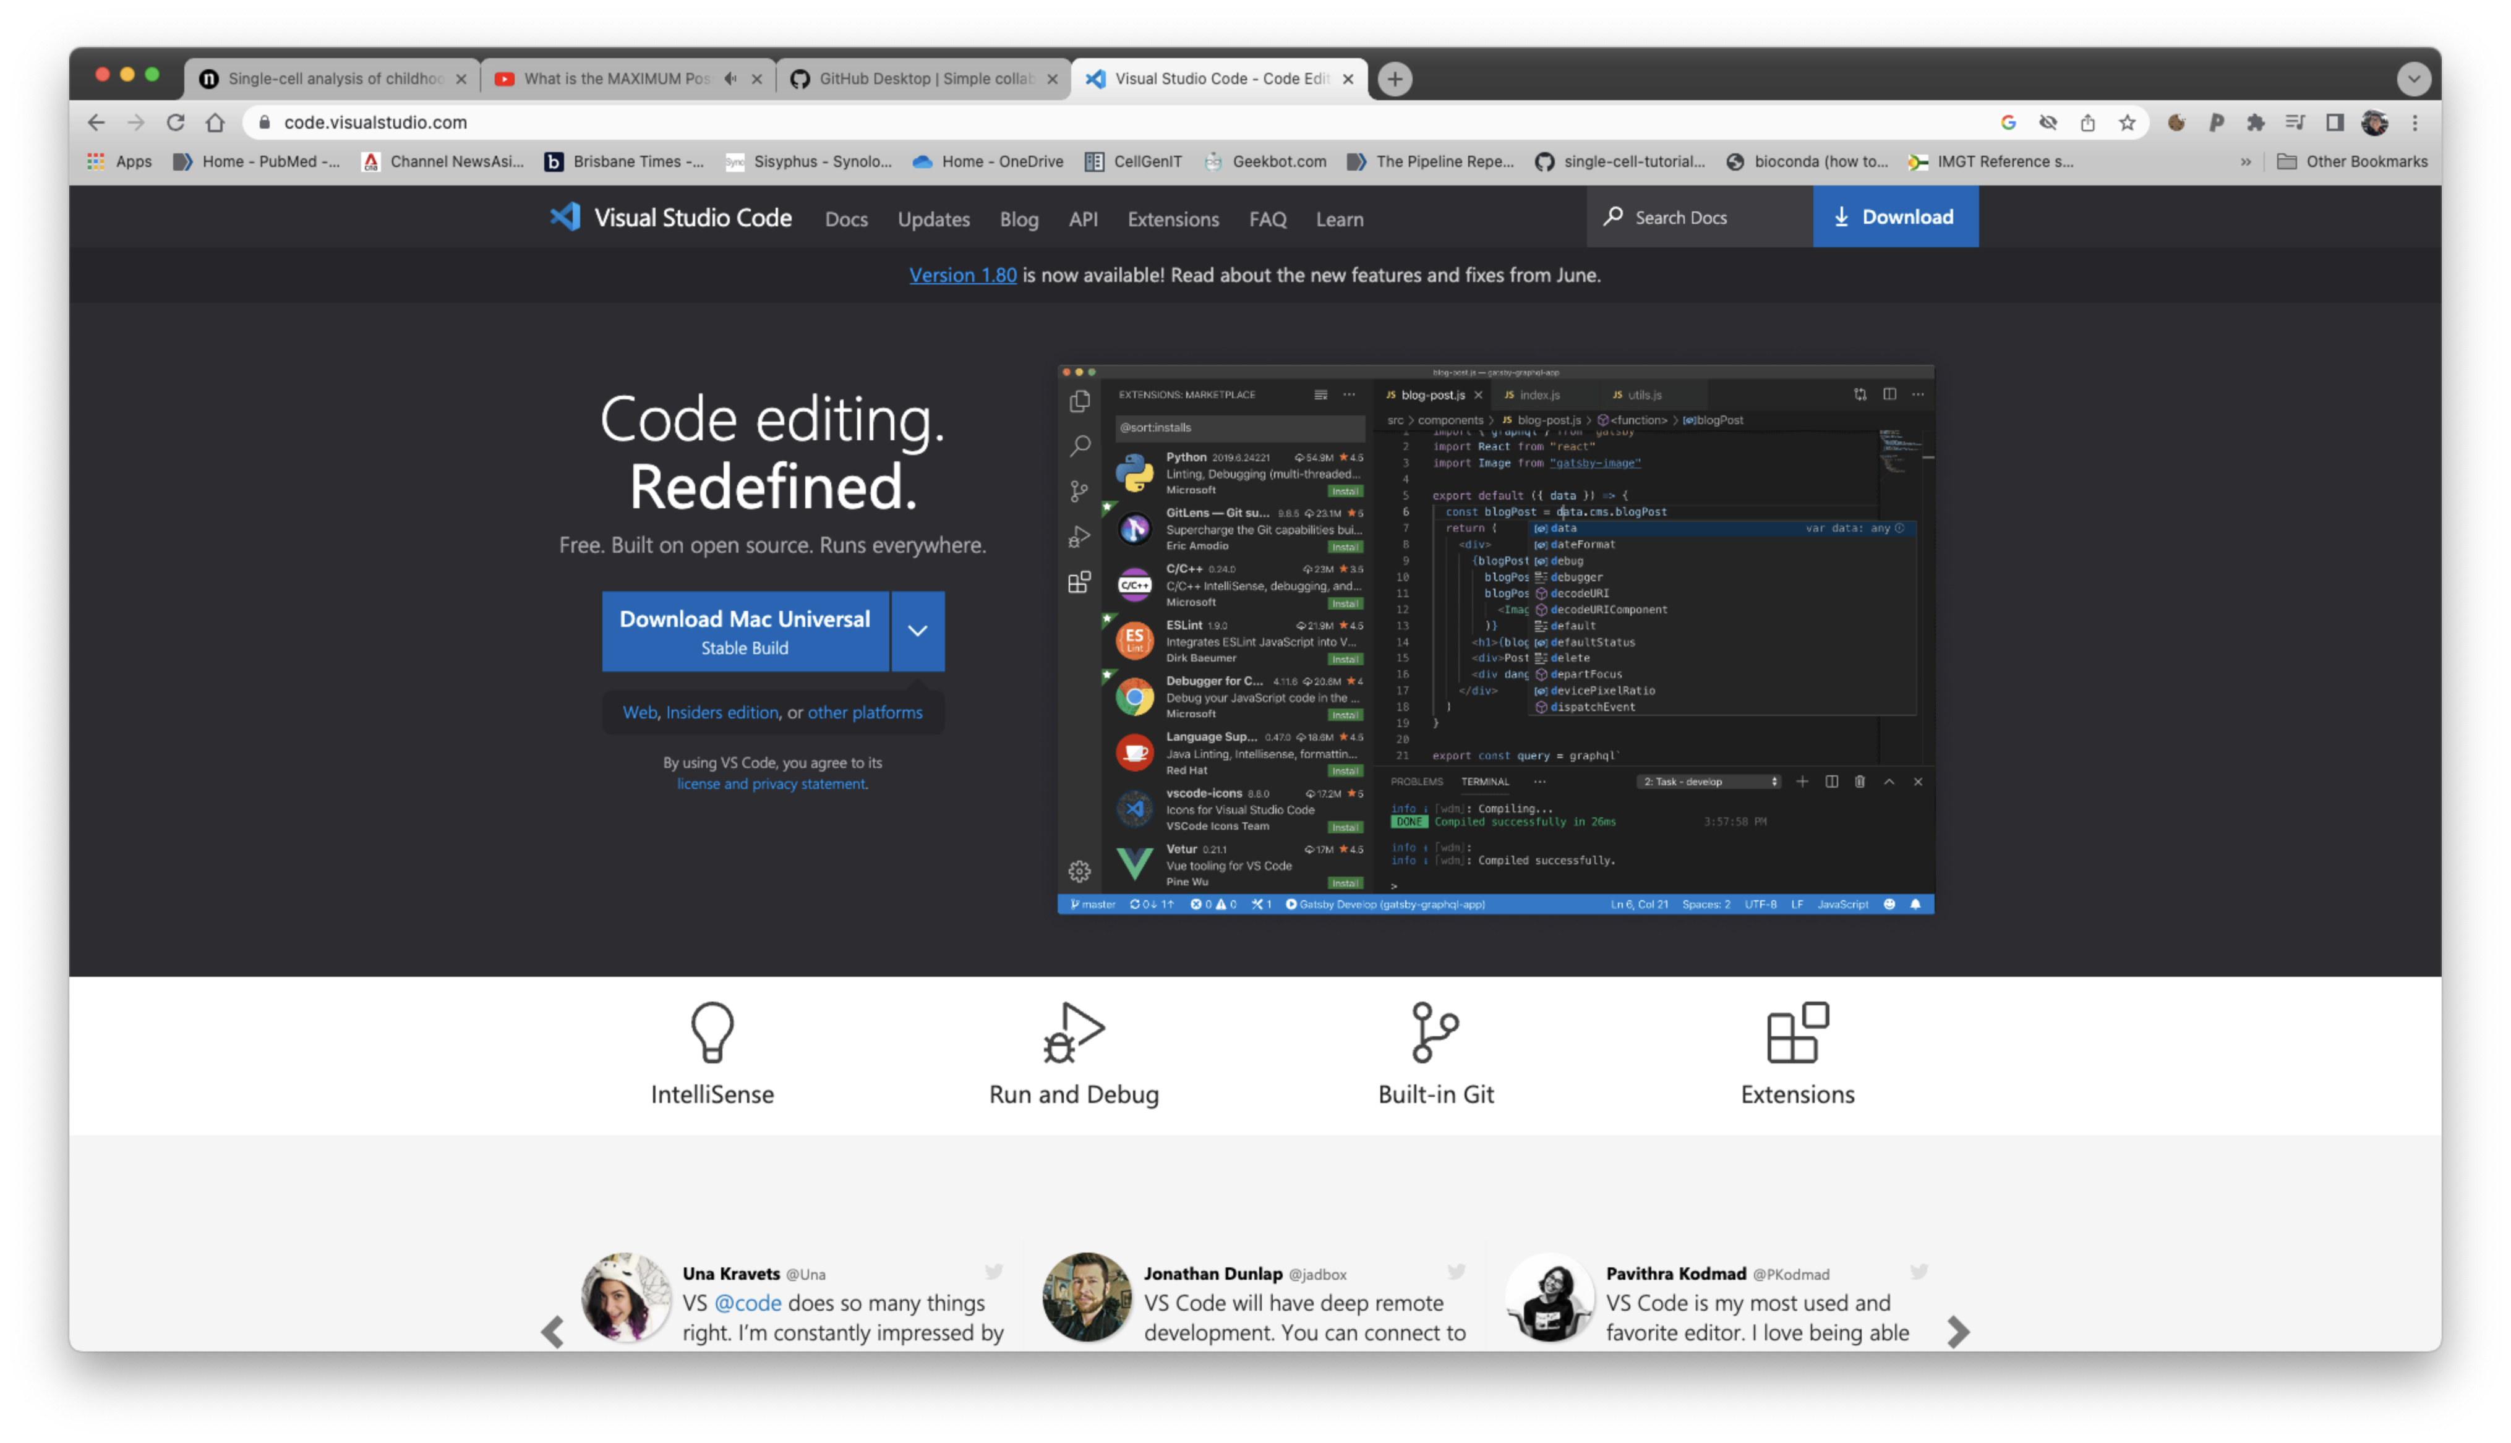
Install VS Code
https://code.visualstudio.com/

Slide 5
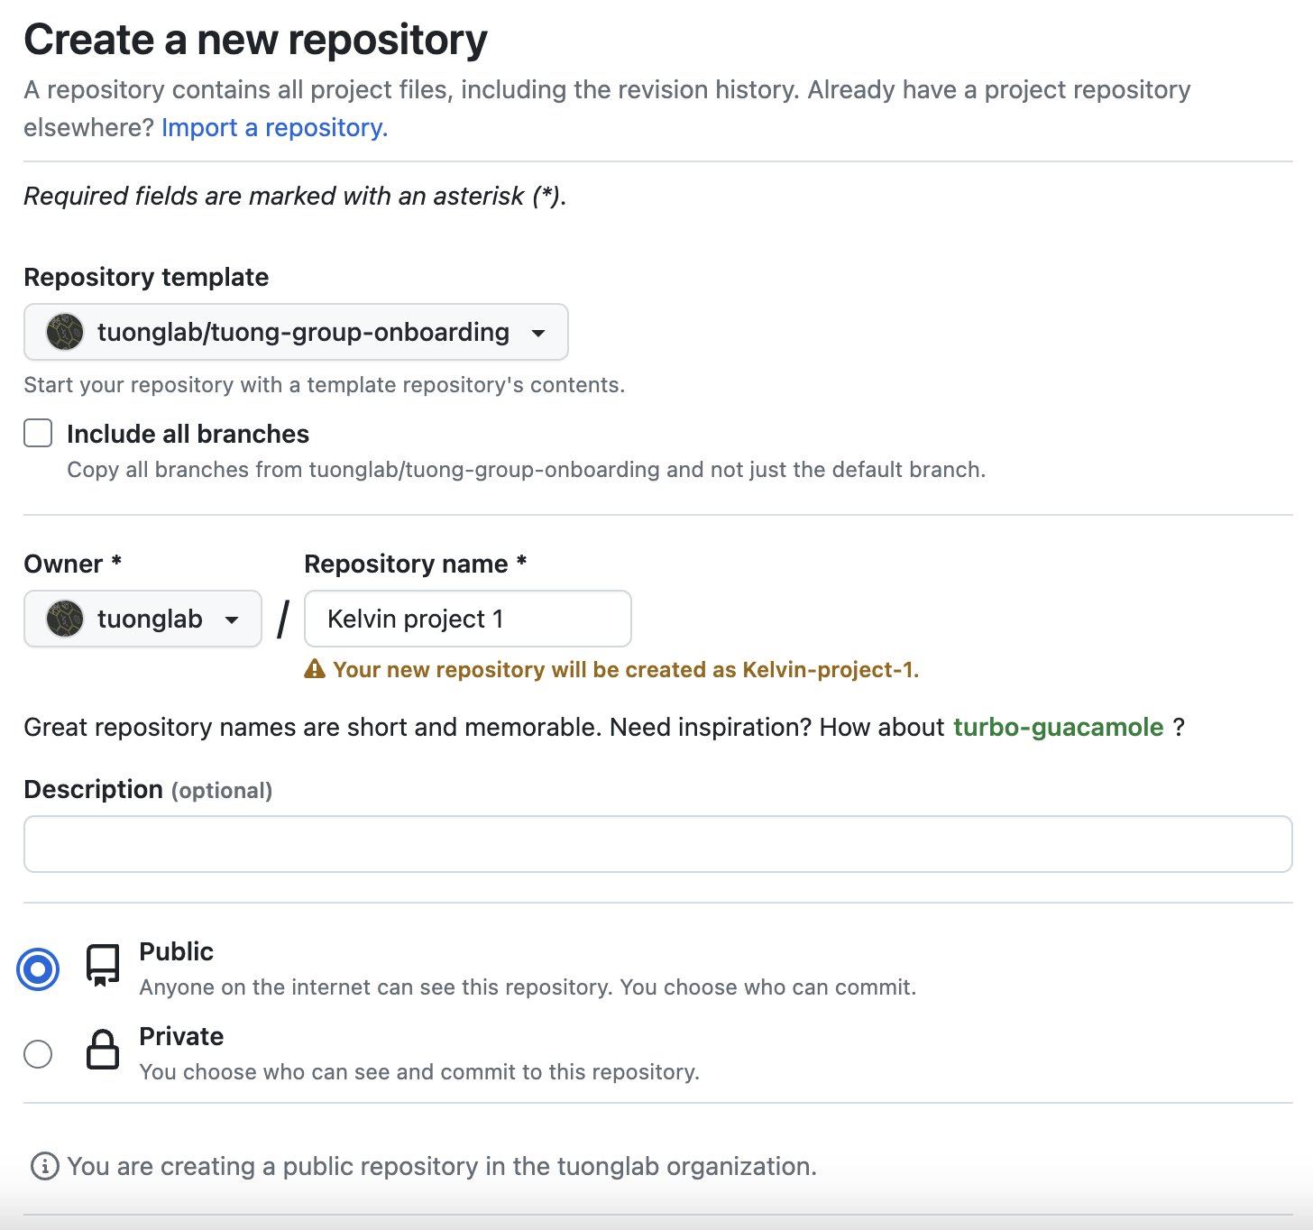
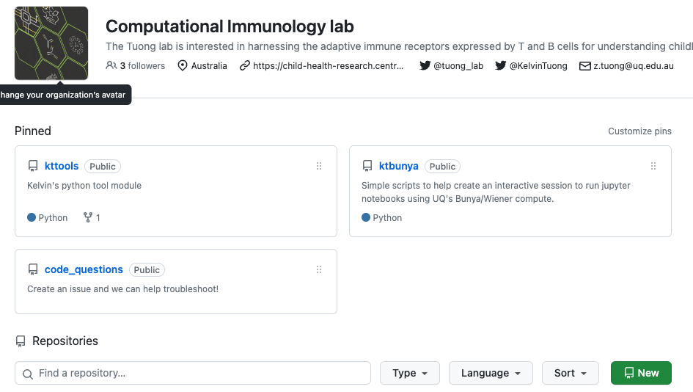
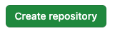
Create a new repository
Call your repository whatever you want
click Create Repository when done
Go to https://github.com/tuonglab and click the New button
I would suggest to make it public if it’s not sensitive data/scripts

Slide 6
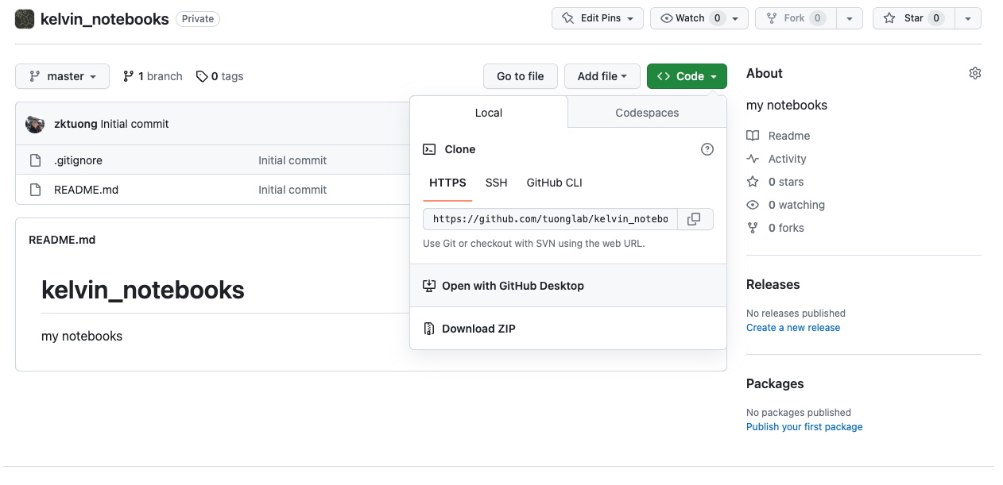
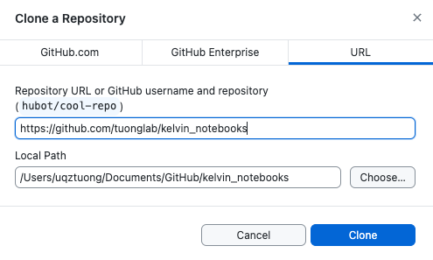
Create a repository - continue
Click Code and select open with GitHub Desktop
Click Clone

Slide 7
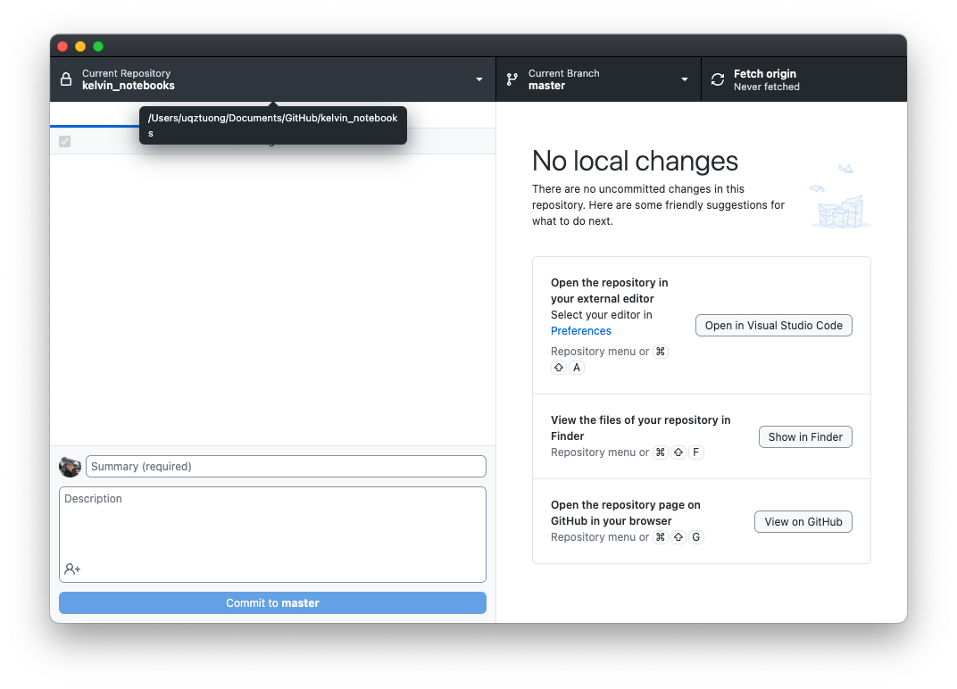
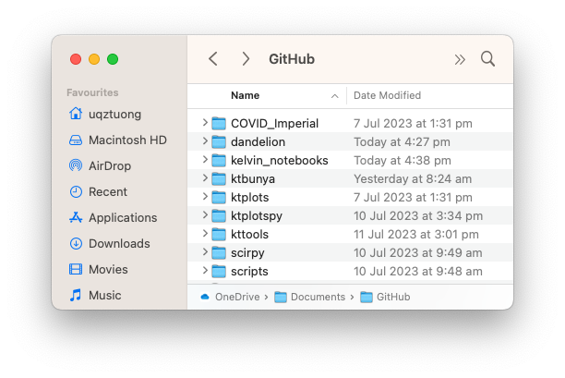
Create a repository - continue
Now you can make changes to this folder
You can find the path by hovering on the left
This is what it will look like.

Slide 8
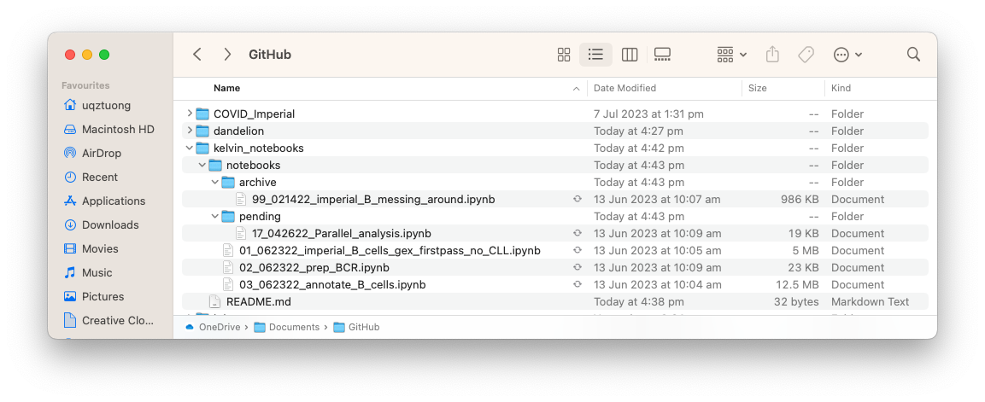
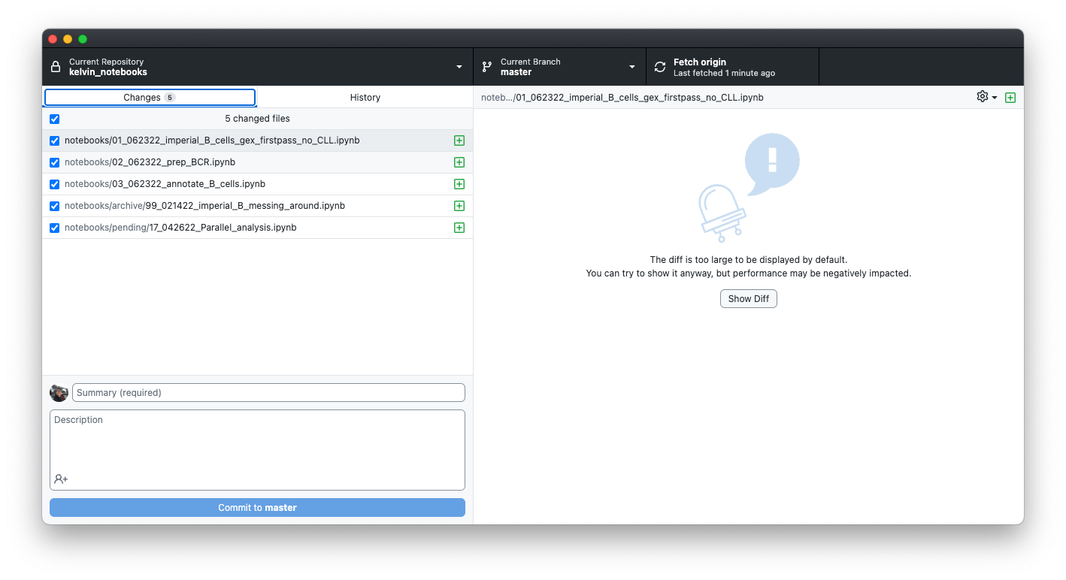
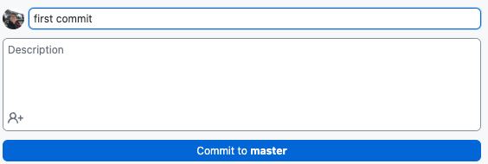
Let’s do some work and put the analysis script into the folder
If you check your GitHub desktop app,
Say I did a bunch of analyses in jupyter notebooks and created folders within the
kelvin_notebooks folder, and then these folders hold my scripts and notebooks
you will see that GitHub Desktop has tracked that you’ve
modified/saved/created some files! Now click the commit button after giving a commit message!

Slide 9
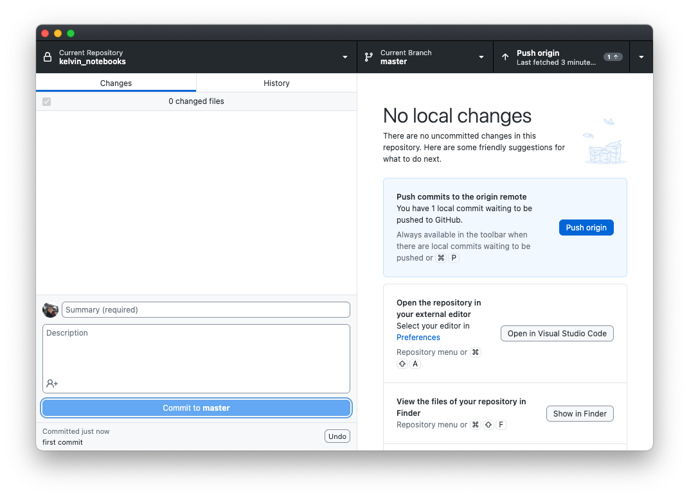
Commit -> Push -> Fetch -> Commit -> Push -> Fetch ad naseum
Once you are ready to push this to github, you can click on the Push button and that will send it online
Before this step, you can always continue to make changes, revert changes etc.

Slide 10
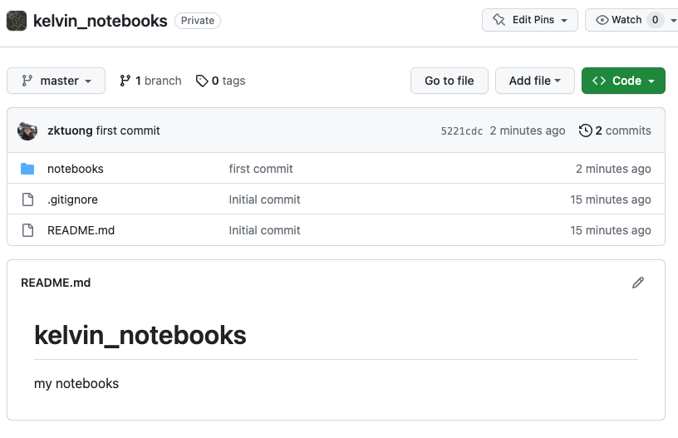
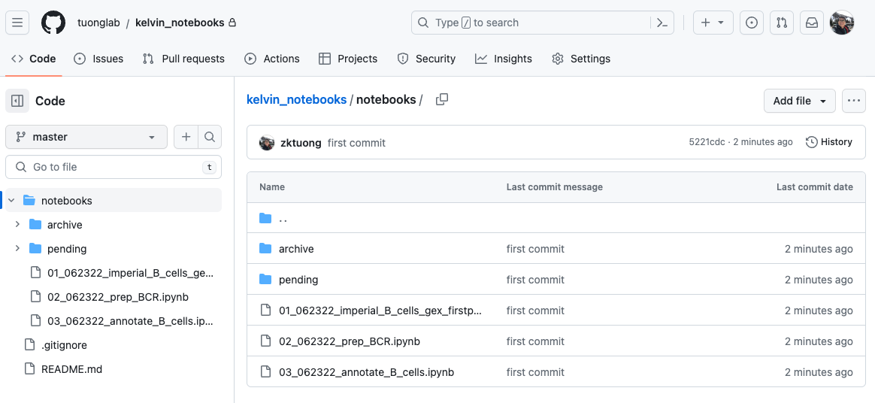
Check your github repo online
Your changes are now live

Slide 11
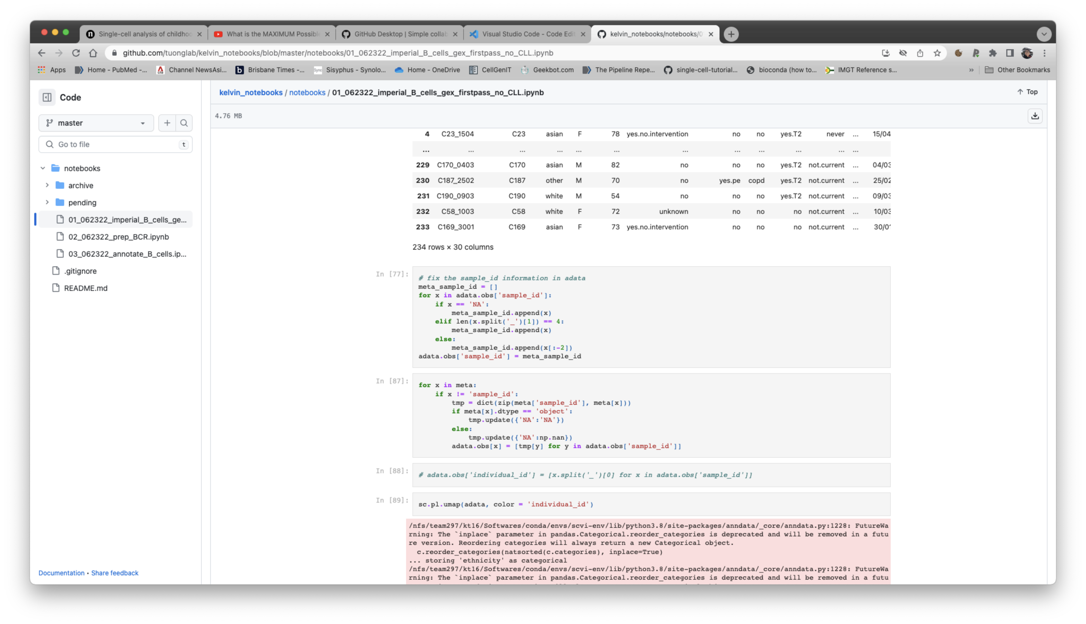
If I were to then take a look at your repo, I can now look at it and give you my feedback live!
I will be able to then interact with you and your code using this method, and also additional ways to help with your progress.

Slide 12
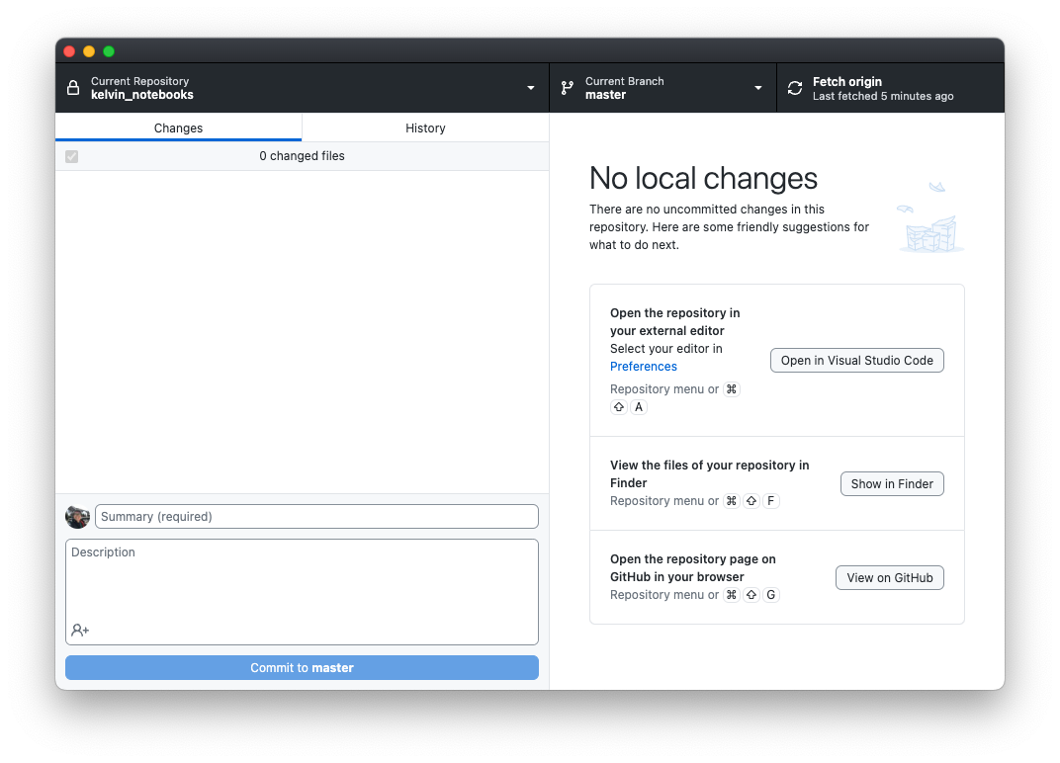
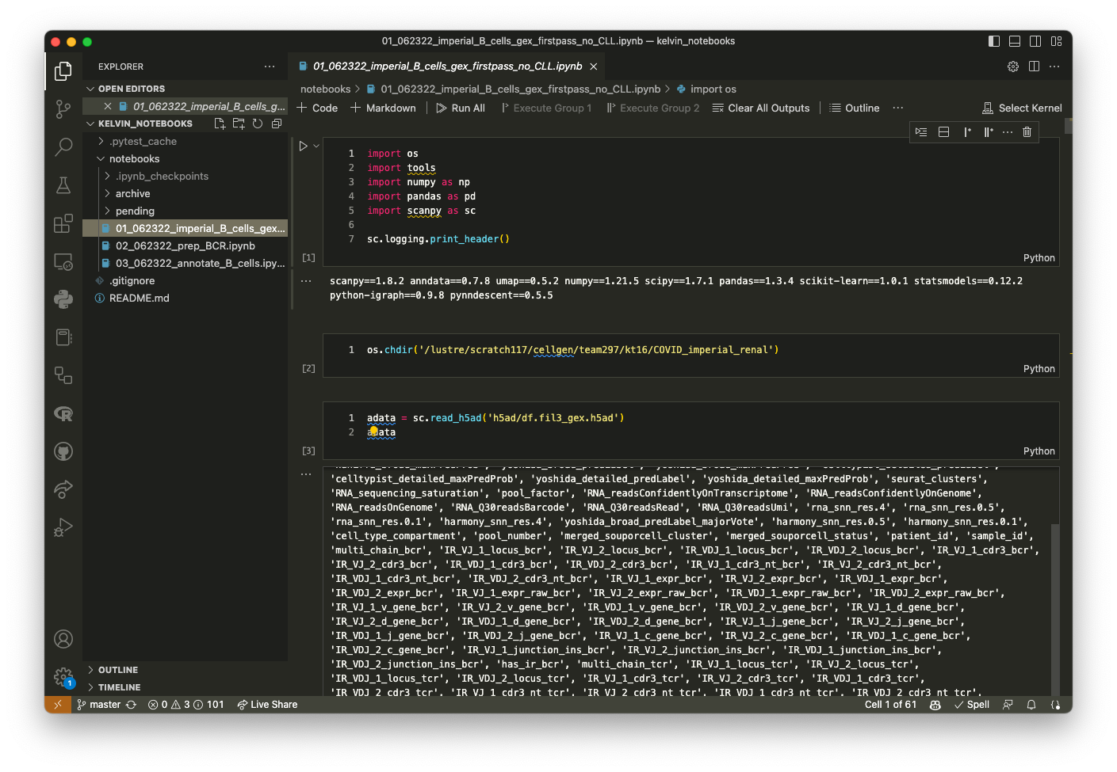
Before we end, why did I tell you to download VS code?
Because you can actually do
(almost) everything just from VS code!

Slide 13
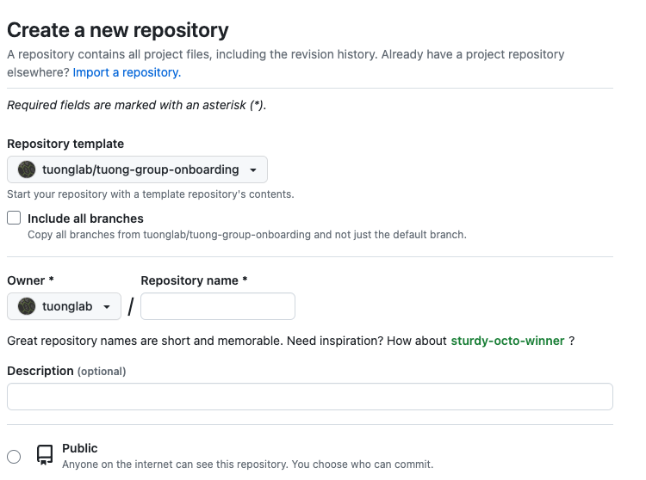
Final words
Basically, the github desktop location will be where you would store your scripts
You wouldn’t upload (push) your actual data to GitHub as there is a size limit for repo. You would upload mostly scripts, notebooks, and notes here and there.
The good thing about this is that actually anything you do on GitHub can be linked to our Slack channel and the the Trello board so it will be very easy to communicate our progress.
When you create a repo using the `tuong-group-onboarding` as a template, then the figures and data folders are ignored – i.e. they won’t get pushed to github so you can store as many as you want here.

